Slide 1
Qubit Arena
Quantum Puzzle Solver Arena
Hack-AI-Thon 2026 | Solution Presentation
© 2026 Infosys Limited. All rights reserved.

Slide 2
Team Introduction
HACK- AI- THON 2026
QUBIT ARENA
COLLEGE
UIET, Panjab University | Chandigarh
TEAM MEMBERS
Mentalists
SELECTED PROBLEM STATEMENT
Comparing exact, heuristic, quantum-inspired and QPU solvers on NP-hard puzzles
TECHNOLOGY TRACK
Other: Quantum-inspired optimization
© 2026 Infosys Limited. All rights reserved.
2

Slide 3
Problem Statement
ACTUAL PROBLEM STATEMENT
WHO IS AFFECTED?
Students, educators and developers exploring quantum optimization
Quantum claims are hard to judge: there is no fair, hands-on way to compare exact, heuristic, quantum-inspired and real-QPU solvers on the same problem.
WHY DOES IT MATTER?
Hype outpaces evidence; reproducible comparisons build accurate intuition.
CURRENT GAP / PAIN POINT
Demos show one algorithm at a time. Exact search blows up, greedy gets trapped, and QPU access is slow and noisy.
EVIDENCE / SCENARIO
Exact search is optimal but O(N!) or O(2ⁿ); greedy takes under 1 ms but can miss the best answer (see the "Greedy Trap" challenge).
SUCCESS DEFINITION
Same seeded puzzle raced across solvers with step-level telemetry, plus a real IBM QPU run to verify.
© 2026 Infosys Limited. All rights reserved.

Slide 4
Proposed Solution
SOLUTION IN ONE SENTENCE
Qubit Arena races exact, greedy and quantum-inspired solvers on identical N-Queens and Knapsack puzzles, so learners see with live telemetry where each approach wins or fails.
1
INPUT
2
PROCESS
3
OUTPUT
›
›
User picks a puzzle (N-Queens, Knapsack, or Sudoku), a size N or capacity W, and the solvers to race. Seeded runs are reproducible.
FastAPI dispatches the job to native C++ engines, D-Wave Neal, or our modern Gate-Based Qiskit QAOA engine.
Animated board and timeline per solver, with steps, time, energy, and dynamic engineering commentary generated by the Qualcomm Cloud AI Referee based on live execution times.
KEY VALUE / DIFFERENTIATOR
Fair, reproducible head-to-head races with live telemetry, plus a real IBM QPU (QAOA) verification path.
WHAT TO SAY
Walk one journey: choose 8-Queens, predict the winner, then watch the race play out.
The prototype proves the API, C++ engines and offline mode work today; QPU runs use standalone scripts.

Slide 5
Architecture & Technical Design
Three tiers: browser UI, local solver API and IBM Quantum cloud.
USER / BROWSER
APPLICATION / LOGIC
SOLVER / AI LAYER
OUTPUT / ACTION
React 19 + TanStack Start UI: Arena, Challenges, Learn, Profile. XP and run history in context.
FastAPI POST /api/solve routes by puzzle and algorithm. A Web Worker runs solvers offline.
C++20 engines, D-Wave Neal (Thermodynamic Annealing), and Qiskit QAOA (StatevectorSampler & COBYLA) on a real IBM QPU.
Normalized JSON telemetry drives the animated board, SVG timeline, winner and XP.
TECHNOLOGY CHOICES
C++20, Python 3.12 (FastAPI, Qiskit, Dimod, Neal), Qualcomm Cloud AI SDK, TypeScript, React 19, Vite, Tailwind.
ENGINEERING RATIONALE
Dependency-free C++ for speed; subprocess JSON keeps engines swappable; a Worker keeps the UI at 60 FPS.
VALIDATION / RELIABILITY
Vitest solver tests, fixed seed 42,
4.5 s timeout guard, offline Worker fallback.
WHAT TO SAY
Left to right: the browser sends a request, FastAPI dispatches to C++ or D-Wave, and telemetry returns as JSON.
Key decision: a dual engine (API plus Web Worker) so the demo never depends on the backend; QPU jobs run separately via Qiskit.

Slide 6
AI Usage & Innovation
Optimization-driven AI, benchmarked against exact baselines rather than added for show.
AI CAPABILITY USED
INNOVATION / DIFFERENTIATION
Engineered Candidate Domain Pruning, compressing a 64-qubit Sudoku matrix down to just 5 active qubits to completely bypass the 16 TiB classical simulation memory crash.
Hybrid AI: Quantum Optimization (QAOA & Annealing) + Generative AI (Qualcomm Cloud Playground).
AI ROLE
Qualcomm Cloud LLM acts as an 'AI Referee', ingesting live race telemetry (e.g., 0.07 ms vs 1500 ms) to dynamically explain the 'No Free Lunch' scaling laws to the user without hardcoding.
INPUT & MODEL
N-Queens board or fixed 8-item Knapsack encoded as binary variables; solved by annealing, D-Wave Neal or Qiskit QAOA.
QUALITY CHECK
The exact solver gives the proven optimum as ground truth; seed 42 makes runs repeatable; a repair loop enforces feasibility.
VALUE CREATED
Turns abstract quantum claims into something users can see, test and predict, with XP for learning.
WHAT TO SAY
We don't just show graphs. When QAOA takes 1.5 seconds and Brute Force takes fractions of a millisecond, our Qualcomm AI agent instantly explains the 'Simulation Tax' and why classical solvers win highly constrained local problems, while quantum scales for unconstrained topologies.

Slide 7



Future Enhancements, Scalability & Security
Credible next steps, with what works today kept separate from what is planned.
NEXT ENHANCEMENTS
SCALABILITY
SECURITY & RESPONSIBLE AI
Custom Knapsack builder: users add their own items and weights
Compile the C++ solvers to WebAssembly for fast browser execution
Move IBM API keys from scripts to environment variables
1
1
1
More puzzles: Travelling Salesperson and Graph Coloring / Max-Cut
Web Worker already keeps heavy compute off the UI thread
Validated inputs (N 4 to 32,
capacity 5 to 40) and CSRF middleware
2
2
2
Stream live IBM QPU job-queue status into the UI over WebSockets
Typed code and Vitest tests keep the codebase maintainable
Clear labels separate quantum-inspired from real QPU results
3
3
3
WHAT TO SAY
Priority: the custom Knapsack builder as one realistic enhancement; key safeguard: keep IBM API keys out of source control. Working now: C++ engines, D-Wave Neal, Worker mode and QAOA scripts; planned: the left column and WebAssembly.

Slide 8
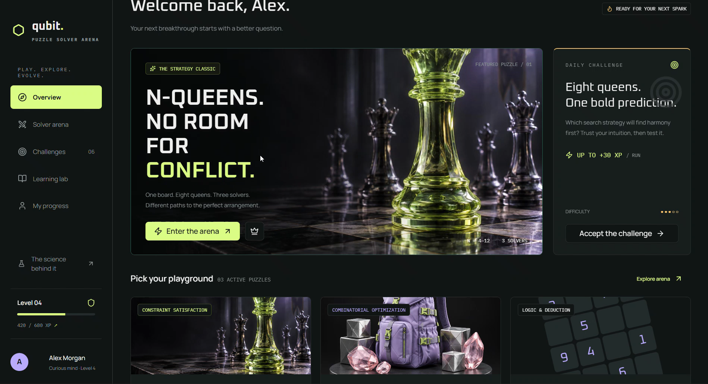
DEMO
Live Arena: N-Queens & Knapsack (Annealing) + Sudoku 'No Free Lunch' Benchmark (QAOA + Qualcomm AI Referee)

